Slide 1

Sales Analysis Report
Ecommerce Website

Slide 2
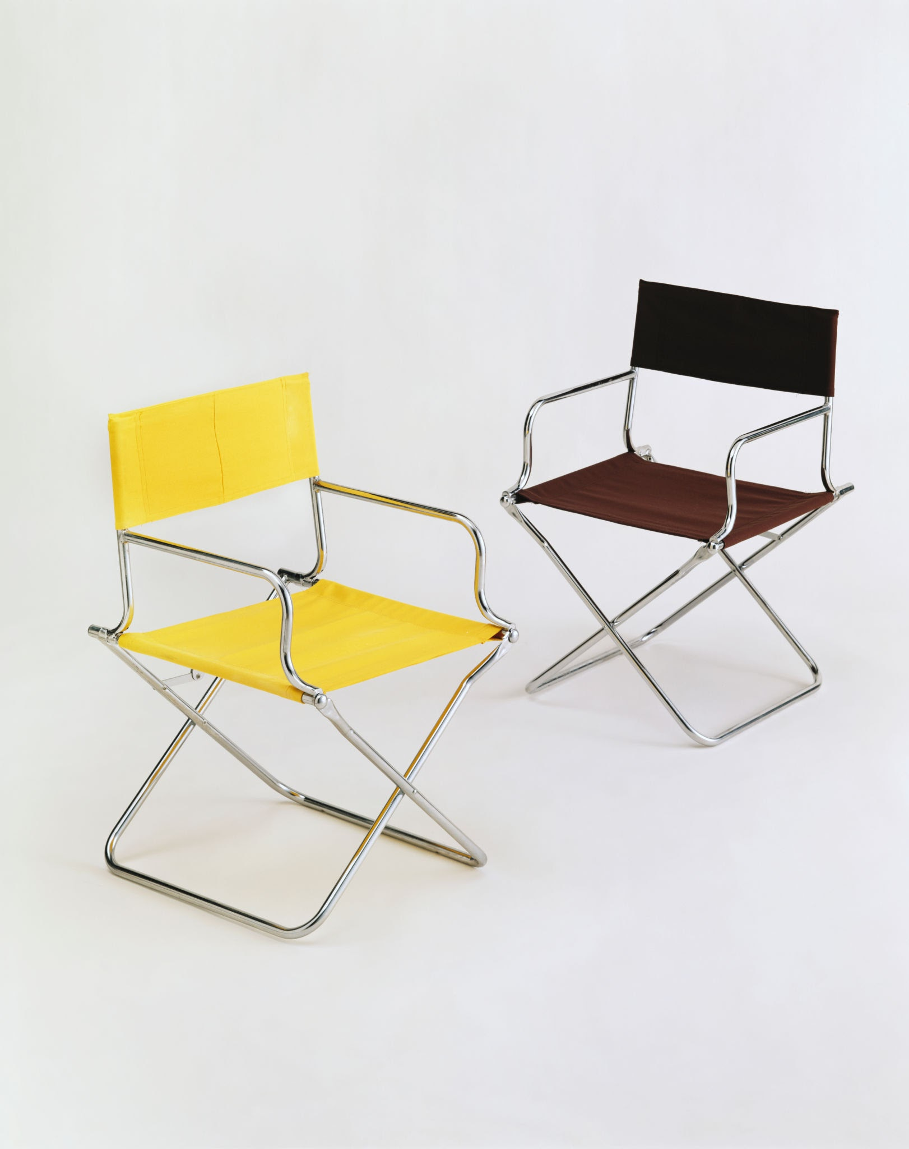
Ecommerce Website
Discussion Points:
1. Regional Analysis
2. Category Analysis
3. Product Analysis
4. Profit Analysis

Slide 3
Regional Analysis
Key Points :-
Ecommerce Website
Demand
East Region perform the best in the Regions as per the Regional Orders.
East Region gets 149579 orders while the other regions get approx. 1 Lakh orders each except the West.
West Region perform worst as it gets only 49708 Orders (i.e. 33.23% of East Orders).
As per the Regional Sales Report, we must focus on Increasing the sales in West Region.
Profit
Sales

Slide 4
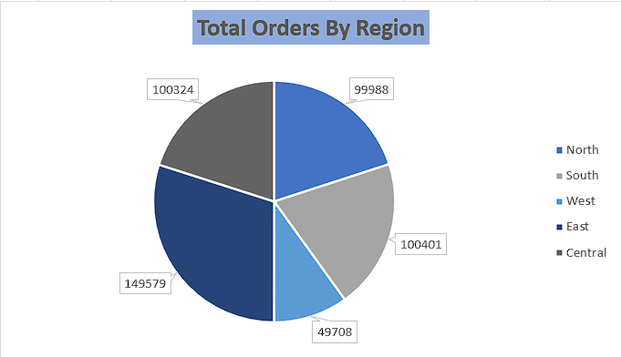
Regional Sales
Ecommerce Website

Slide 5
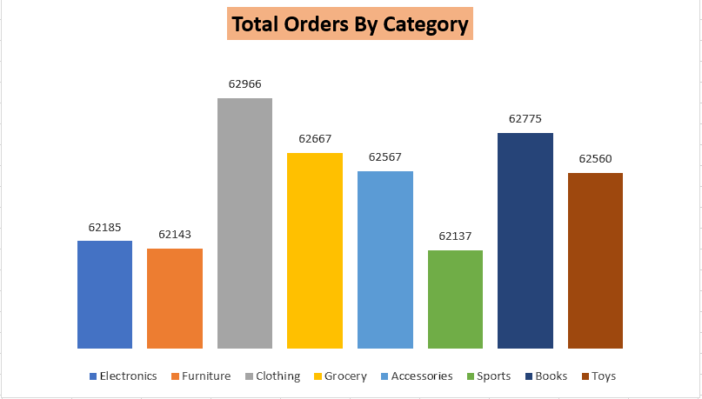
Category Analysis
Key Points :-
Ecommerce Website
Clothing Category has the highest number of orders among the Category List.
Top 3 Category by number of orders are Clothing, Books, and Grocery with 62966, 62775, and 62667 orders respectively.
Sports & Furniture has the lowest orders (i.e. 62137 & 62143) respectively.
As per the Category Sales Report, each Category getting approx. 62000 orders.

Slide 6
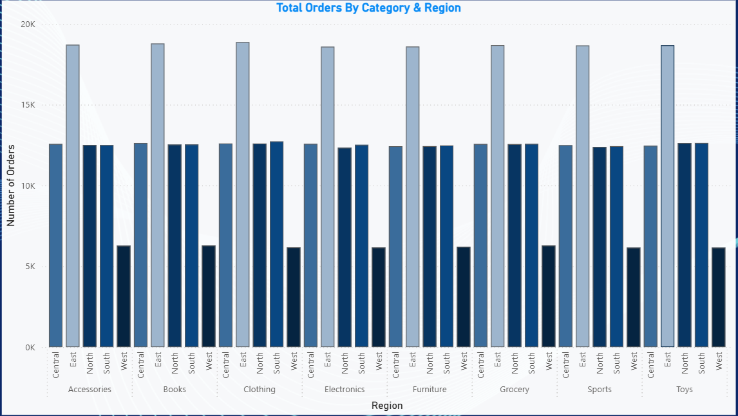
Category By Region
Key Points :-
Ecommerce Website
East Region perform the best in each Category as per the Category Orders Report.
Central, North, & South Region in each Category are nearly Constant.
West Region perform worst in each Category when grouped by number of Orders.
As per the Category Sales Report, we must focus on Increasing the sales in West Region.

Slide 7
Product Analysis
Key Points :-
Ecommerce Website
Cap
Tie
Shorts
Religion Book
Knee Guard
Ring
Art & Craft Kit
Scarf
Toy Microphone
Children StoryBook
Top 10 Products
Cap has the highest orders followed by Tie, Shorts, and so on.
Cap has 2569 orders over the 5 Regions.
Top 3 has 2500 orders each while other 7 has 1300 orders each.
Cap, Tie, & Scarf are Common Top Products in East Region compared to the Overall Top 10 ordered products.

Slide 8
Profit Analysis
Key Points :-
Ecommerce Website
Cargo Pants
Biscuits
Track Pants
Anklet
Vacuum Cleaner
Kite
Wall Shelf
Anarkali Dress
Toy Camera
Blazer
Bluetooth Speak
Umbrella
Tea Powder
Bar stool
Wrist Watch
Printer
Skirt
Ring
Water Gun
Cricket Pads
Top Profitable
Least Profitable
The 8 Category has total 400 products.
Ring is One of the Top Ordered Product but the Profit on Ring is Least.
Clothing Category is One of the most Ordered Category and Profitable Category as per Profit Analysis Report.
Furniture is the Least Ordered Category but as per Profit Sales Report, it has good Profit Margin.
As per the Profit Sales Report, we are gaining most profits from Books, Grocery, Clothing, and Accessories.

Slide 9
Ecommerce Website
30%
of our orders are generated by East Region.
20%
of our orders are generated by South Region.
20%
of our orders are generated by Central Region.
20%
of our orders are generated by North Region.
10%
of our orders are generated by West Region.

Slide 10
Presented By: Roshan S Bisne
THANK YOU
Ecommerce Website

